Slide 1
Shell Bootcamp 2024 3 Reflections for Week #1
Khushi Garg
Date : 30-Aug-2024

Slide 2

About Me
Stay vigilant, trust but verify, and protect what matters.

Slide 3

My learnings from this week!

Slide 4
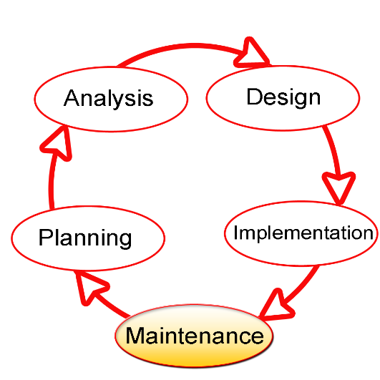
Learning 1 | My takeaways
Key learning
SDLC Model (Software development life cycle)
A framework that describes that activities performed at each stage of a software project.
This Photo by Unknown Author is licensed under CC BY-SA

Slide 5
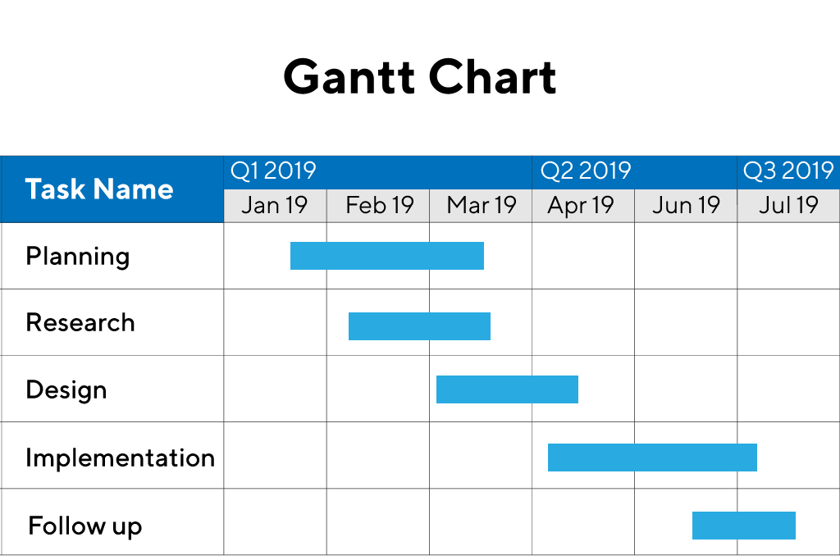
Learning 2 | My takeaways
Key learning
A Gantt chart is a visualization that helps in scheduling, managing, and monitoring specific tasks and resources in a project.
It consists of a list of tasks and bars depicting each task’s progress.

Slide 6
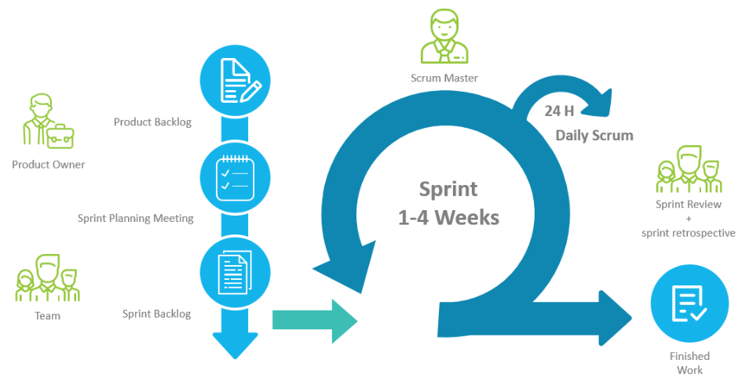
Learning 3 | My takeaways
Key learning
Benefits of Scrum
Adaptability
Continuous Improvement
Sustainable Pace
Motivation
Costumer Centric

Slide 7

Learning 4 | My takeaways
Key learning
Benefits of Teamwork
Encourages personal growth and Increases job satisfaction
Reduces stress Increases efficiency by sharing the workload
Boosts accountability and morale

Slide 8

Relevance of learnings for my organization

Slide 9

Learning 1 | Relevance for Shell
How I feel Shell implements this learning
Shell uses SDLC to manage operations, automate processes, and improve digital services , integrating SDLC practices for efficient system development and maintenance.

Slide 10
Learning 2 | Relevance for Shell
How I feel Shell implements this learning:
Agile Training
Business analysis tools
Pilot Agile Project
Continuous Feedback
How I feel Shell benefits from this learning:
Faster Time-To-market
Enhanced Flexibility
Data-Driven Decision

Slide 11
Learning 3 | Relevance for Shell
How I feel Shell implements this learning:
Cross-Functional Teams
Daily Stand-Ups
Sprint Reviews and Retrospectives
WIP Limits
Relative Estimation
How I feel Shell benefits from this learning:
Improved Efficiency
Enhanced Flexibility
Increased Transparency

Slide 12
Learning 4 | Relevance for Shell
How I feel Shell implements this learning:
Team building Activities
Cross-Functional Team
Clear Roles and Responsibilities
Recognition and Reward
How I feel Shell benefits from this learning:
Increased Innovation
Higher Productivity
Employee Engagement

Slide 13

Challenges in implementing learning

Slide 14

Challenge faced while implementing Learning 1
Challenge faced while implementing:
Cultural Resistance
Consistency across Regions
Measurement and Accountability
Time Constraints

Slide 15
Challenge faced while implementing Learning 2
Challenge faced while implementing:
Adoption of agile suddenly
Training and Expertise
Integration with my existing knowledge
Continuous adaption

Slide 16
Challenge faced while implementing Learning 3
Challenge faced while implementing:
Consistency in Story pointing
Implementation Delays
Maintaining Discipline
Excessive Training

Slide 17
Challenge faced while implementing Learning 4
Challenge faced while implementing:
Geographical Dispersion
Diverse Work Cultures leading to misunderstanding sometimes
Role Clarity Issues
Resistance to change

Slide 18

Action Plan

Slide 19
My Action Plan for this Week
Actions
Timeline
Status
Learning more about Azure DevOps and the sprints formation.
Setting up PostgreSQL and working on that
Making more friends
1 Week
Ongoing

Slide 20

Learning is also Fun!

Slide 21

Learning is also Fun!
My learning was fun this week because of following reasons:
Roleplay
Chart making
In class presentations
Assessments
Playing Games
Networking with colleagues

Slide 22

Summary
Professionalism: We learned the importance of consistent behavior and clear communication, though adapting these standards globally and measuring their impact was challenging.
Teamwork: Enhancing teamwork boosted innovation and productivity but bridging geographical and cultural gaps was a challenging part of the journey.
Business Analysis and Agile: Adopting Agile practices made us more flexible yet integrating them with existing processes and ensuring proper training required a major shift.
Stakeholder Management: Managing diverse stakeholder needs improved our collaboration but balancing conflicting interests and overcoming communication barriers required significant effort.

Slide 23
Thank You

